Slide 1
Crunching the Numbers: EDA of Chips Industry Data A QUANTIUM Job Simulation
Presented by: Avik Sarkhel

Slide 2
Task 1
Data Analysis of Customer Purchase Behavior

Slide 3
Project Overview
Project Source: QUANTIUM Job Simulation (Forage Website)
Objective: Analyze customer purchase behavior in the chips industry
EDA Performed Using: Google Colab (Python, Pandas, NumPy, Matplotlib, Seaborn)

Slide 4
Objective
Goal:
Analyze customer purchase behavior using transaction and customer datasets.
Identify trends in spending habits, customer segmentation, and product preferences.
Data Sources:
purchase_behaviour.csv – Contains 72,637 records, mapping customers to their purchasing category (Mainstream, Budget, Premium).
transaction_data.csv – Contains 264,836 records, detailing individual transactions, including product details and purchase amounts.

Slide 5
Datasets Used
Dataset 1: Purchase Behavior
Records: 72,637
Columns: Loyalty Card No, Life-stage, Premium Customer
Format: CSV
Dataset 2: Transaction Data
Records: 264,836
Columns: Date, Store No, Loyalty Card Number, Transaction ID, Product No, Product Name, Product Quantity, Total Sales
Format: Worksheet (converted to CSV for processing)

Slide 6
Data Processing
Imported Libraries: Pandas, NumPy, Matplotlib, Seaborn
Uploaded Datasets to Google Drive & Mounted in Colab
Merged Datasets on 'Loyalty Card No’
Final Merged Dataset: 264,836 records, 10 columns
Unique Loyalty Card Numbers: 72,637
Checked for Null Values: None Found

Slide 7
Data Cleaning
Company Name Standardization
Found inconsistencies in company names (e.g., 'Red Rock Deli' vs. 'RRD’)
Created a dictionary to map all variations to standardized names
Used ChatGPT for initial mapping, then manually refined it
Created a new column: 'Company Name’
Removed Incomplete Records:
'French Fried Potato Chips' had no company name
Removed 1,418 records containing this product
Date Format Issue: Unable to fix, kept as-is

Slide 8
Exploratory Data Analysis (EDA)
Key Analysis Areas:
Top 5 Chip Brands
Customer Segmentation by Lifestage (Age Groups)
Customer Segmentation by Premium/Budget/Mainstream (Premium Customer Column)

Slide 9
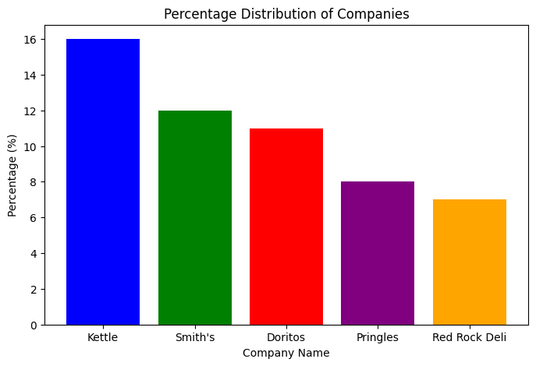
Visualisation 1: Top 5 Chip Brands
Kettle (16%) is the most popular chip brand, leading in sales.
Smith’s (12%) and Doritos (11%) are the next most purchased, showing strong consumer preference.
Pringles (8%) and Red Rock Deli (7%) have a smaller but significant market share.
The trend suggests that consumers prefer premium or well-established brands in the chips market

Slide 10
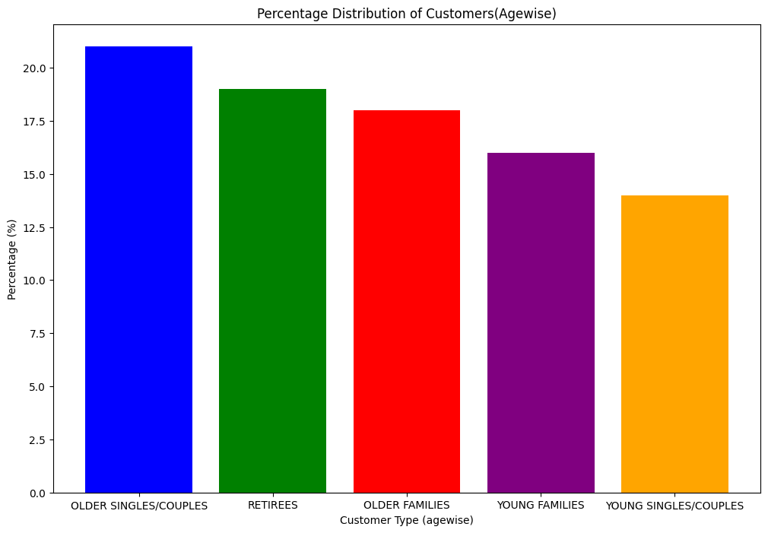
Visualization 2 - Customer Segmentation by Life-stage
Older Singles/Couples (21%) are the largest segment of chip buyers, indicating that this group has a strong preference for chips.
Retirees (19%) and Older Families (18%) also have a significant share, suggesting that older age groups are key consumers in this market.
Young Families (16%) and Young Singles/Couples (14%) have a lower but still considerable presence, indicating that younger demographics also engage in chip purchases, though to a lesser extent.
This trend suggests that chips are popular across all age groups, but older individuals and families tend to purchase them more frequently.

Slide 11
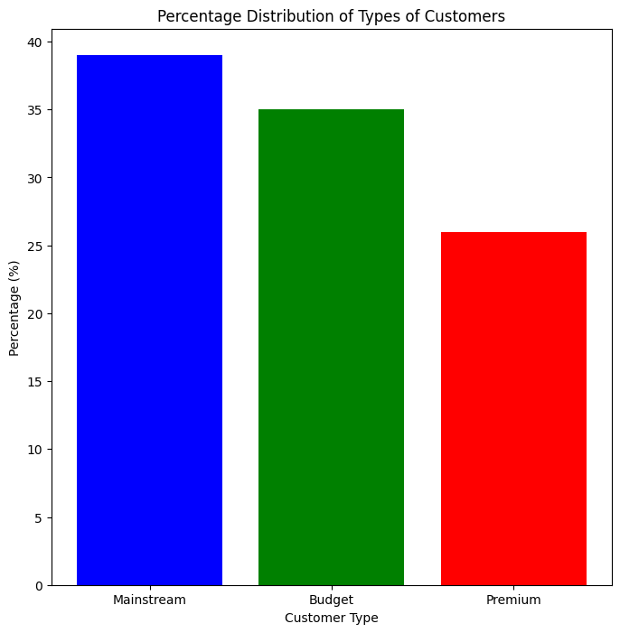
Visualization 3 - Customer Segmentation by Premium/Budget/Mainstream
Mainstream customers (39%) form the largest segment, indicating that the majority of customers prefer standard-priced chips rather than high-end or budget options.
Budget customers (35%) are also a significant group, suggesting that a large portion of customers are price-conscious and opt for more affordable chips.
Premium customers (26%) represent the smallest segment, implying that fewer consumers are willing to pay extra for high-end chip brands.
This data suggests that chip companies should primarily focus on mainstream and budget product lines while maintaining premium options for niche consumers.

Slide 12
Task 2
Finding Control Stores for Trial Stores

Slide 13
Project Overview
Objective: Identify control stores for trial stores based on sales performance metrics.
Dataset: Cleaned dataset with 264,834 records and 12 columns.
Trial Stores: 77, 86, 88
Trial Period: February 2019 – April 2019
Data Range: July 2018 – June 2019

Slide 14
Control Store Selection Methodology
Performance Similarity Measures:
Total Sales Revenue
Total Number of Customers
Average Transactions per Customer
Methods Used:
Magnitude Distance Formula
Pearson Correlation
Pre-trial & Trial Period Division:
Pre-trial: July 2018 – January 2019
Trial: February 2019 – April 2019

Slide 15
Control Store Selection Process
Data Preprocessing:
Converted DATE column to datetime format
Filtered dataset for the required date range
Removed 'French Fried Potato Chips' records
Aggregated Store Metrics:
Computed total sales, unique customers, and avg. transactions/customer
Similarity Calculation:
Calculated Euclidean Distance and Pearson Correlation
Selected Control Stores:
Identified best-matching stores for each trial store

Slide 16
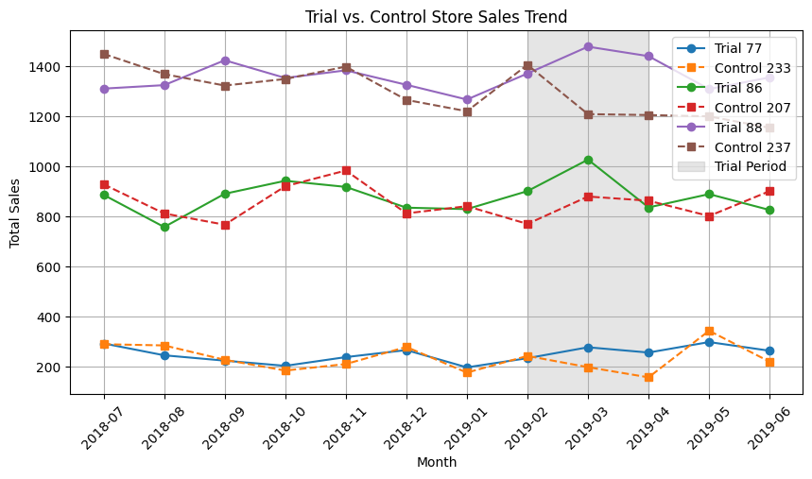
Visualisation 1: Total Sales Comparison
Trial's impact on sales varied across stores. Some trial stores saw increased sales, while others didn't.
Trial 88 and Control 237 consistently had the highest sales.
Trial 77 and Control 233 consistently had the lowest sales.
Sales fluctuated throughout the year, suggesting seasonality or other factors.
The trial period seemed to have a more noticeable impact on customer count than on sales.
Store 86 saw the most significant increase in customers during the trial but also had a declining trend before and after.

Slide 17
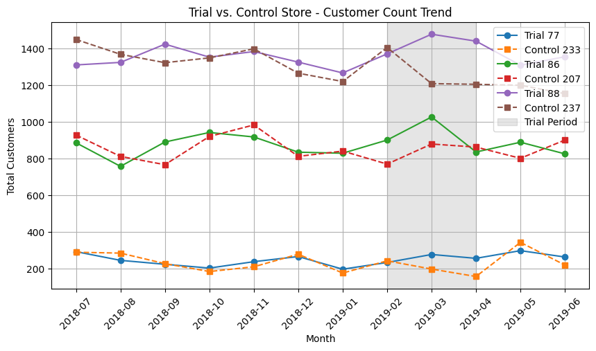
Visualization 2: Total Customers Comparison
Trial stores (77, 86, 88) generally saw an increase in customer count during the trial period (Feb-Apr 2019), while control stores remained relatively flat.
Trial store 86 showed the most significant increase during the trial, but also had a declining trend before and after.
Control store 233 had the highest overall customer count.
Performance of trial stores varied, suggesting the trial had different impacts depending on the store.

Slide 18
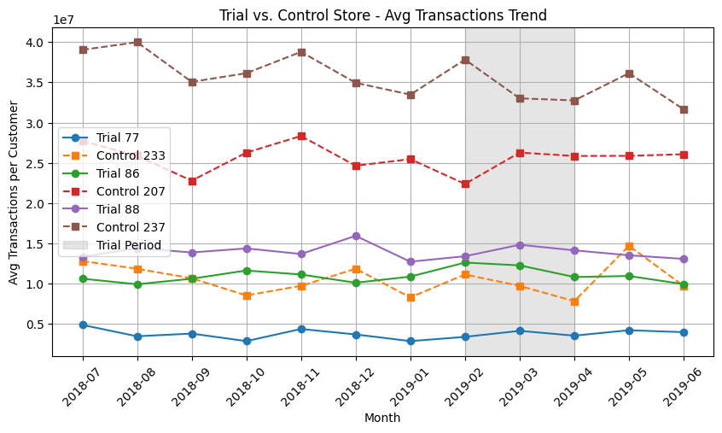
Visualization 3: Avg Transactions Per Customer
Control 237 consistently had the highest average transactions per customer.
Trial 77 consistently had the lowest average transactions per customer.
Trial 86 showed a slight increase in average transactions during the trial period, but the effect is not dramatic.
The trial period (shaded gray) had a limited and varied impact on average transactions across different stores.
There are fluctuations in average transactions across all stores throughout the year, suggesting potential seasonality or external factors.
The average transactions per customer for most stores remained relatively stable throughout the year, with no significant upward or downward trends.

Slide 19
Conclusion
Key Findings from Task 1
Identified top chip brands, customer segments, and spending behaviors.
Older Singles/Couples and Retirees dominate chip purchases.
Mainstream and budget customer segments form the majority of the market.
Key Findings from Task 2
Successfully identified control stores using similarity measures.
Sales, customer count, and transaction patterns closely match trial stores.
Control stores provide a reliable benchmark for trial store performance evaluation.
Next Steps
Further analysis on trial store performance post-trial period.
Evaluate marketing intervention effectiveness

Slide 20
Thank You!
Have any questions? Feel free to reach out:
📧 Email: avik305sarkhel@gmail.com
🔗 Job Simulation Link [Click Here]
📂 GitHub Repository [Click Here]

